Slide 1
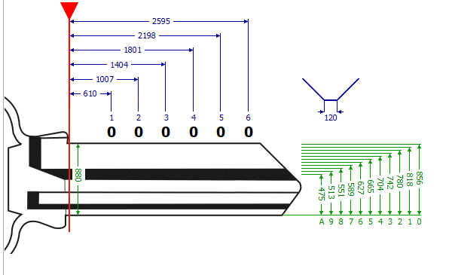

Slide 2
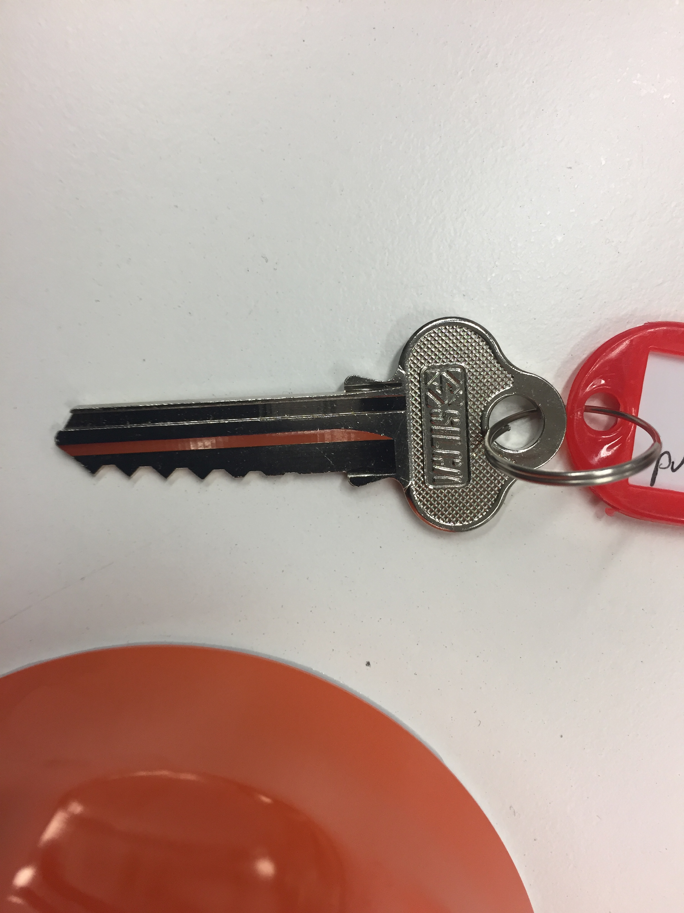
Std 2 photo taken using still camera
0
1
2
3
4
5
6
7
8
9
A
1
2
3
4
5
6

Slide 3
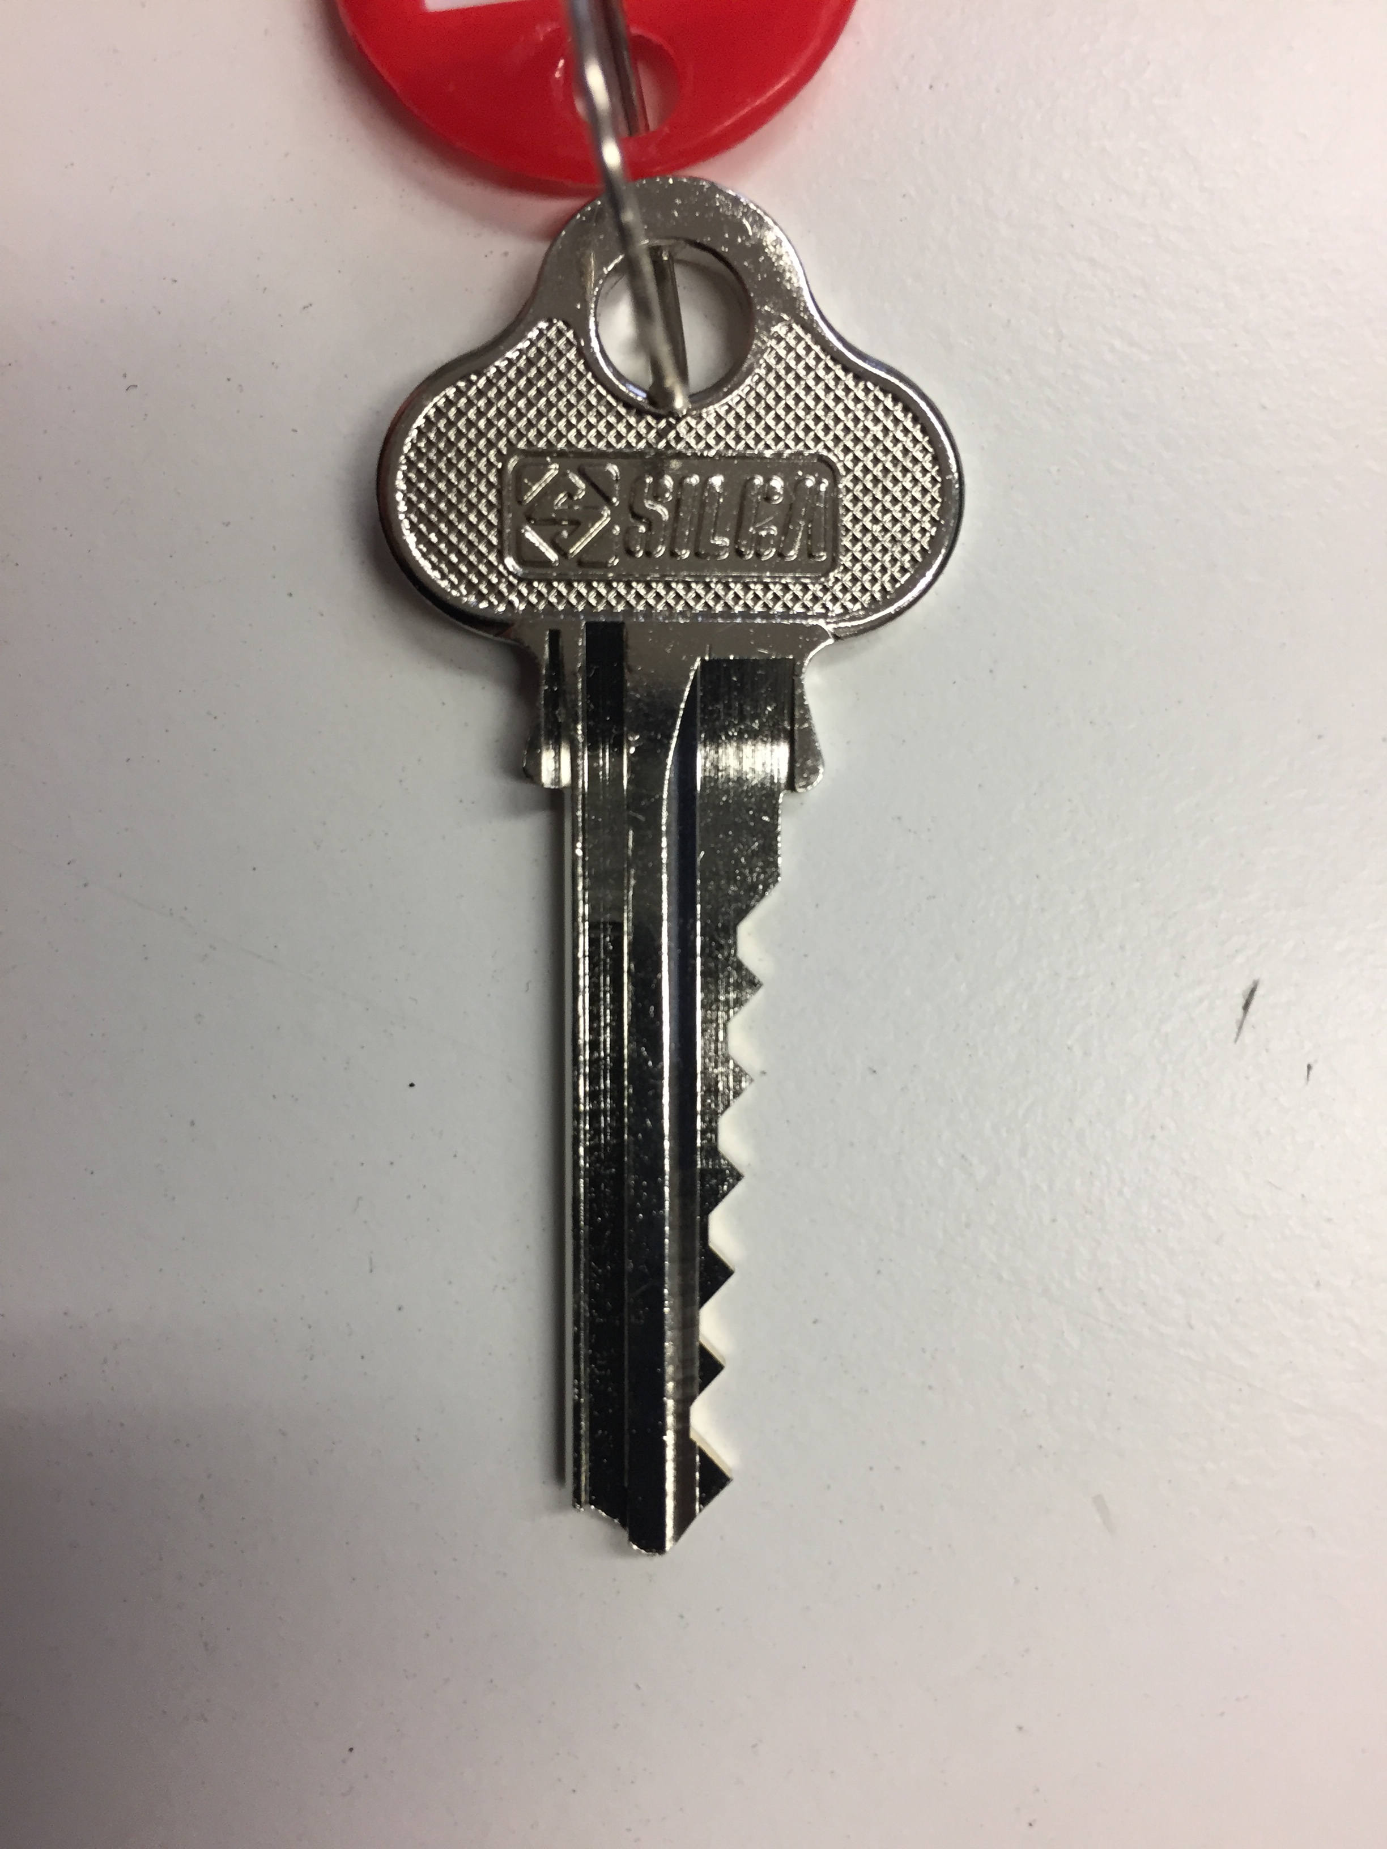
Std 2
Std 2
EC1
0
1
2
3
4
5
6
7
8
9
A
1
2
3
4
5
6

